Slide 1
Extracting Sunbeams Out of Cucumbers:
Why Archaeology Isn‘t a Science, and How It Can Become One
Ben Marwick
ARC Future Fellow, UOW
Associate Professor, UW
bmarwick@uw.edu
Summer School "Reproducible Research In Landscape Archaeology“ by the Excellence Cluster Topoi, Freie Universität Berlin, the Collaborative Research Centre 1266 “Scales of Transformation: Human-Environmental Interaction in Prehistoric and Archaic Societies” and Christian-Albrechts-Universität zu Kiel.

Slide 2
1. What is a science, these days?
2. Why isn’t archaeology a science?
3. How to be a science
What philosophers say, what scientists say, what archaeologists say
What do archaeologists do?
What archaeologists can do to become a community of scientific researchers
Notes:
Popper (failed), Lakatos (best)… Merton (ideals)… Ziman… behaviours: data sharing, code sharing
On archaeology few hard cores… data sharing, journal policies, use of repositories
Story of the title… My open science paper

Slide 3
What is a science?
Notes:
http://onlinelibrary.wiley.com/doi/10.1111/j.1945-5100.1999.tb01388.x/epdf

Slide 4
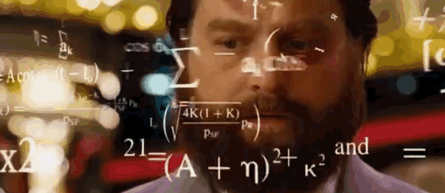

Slide 5
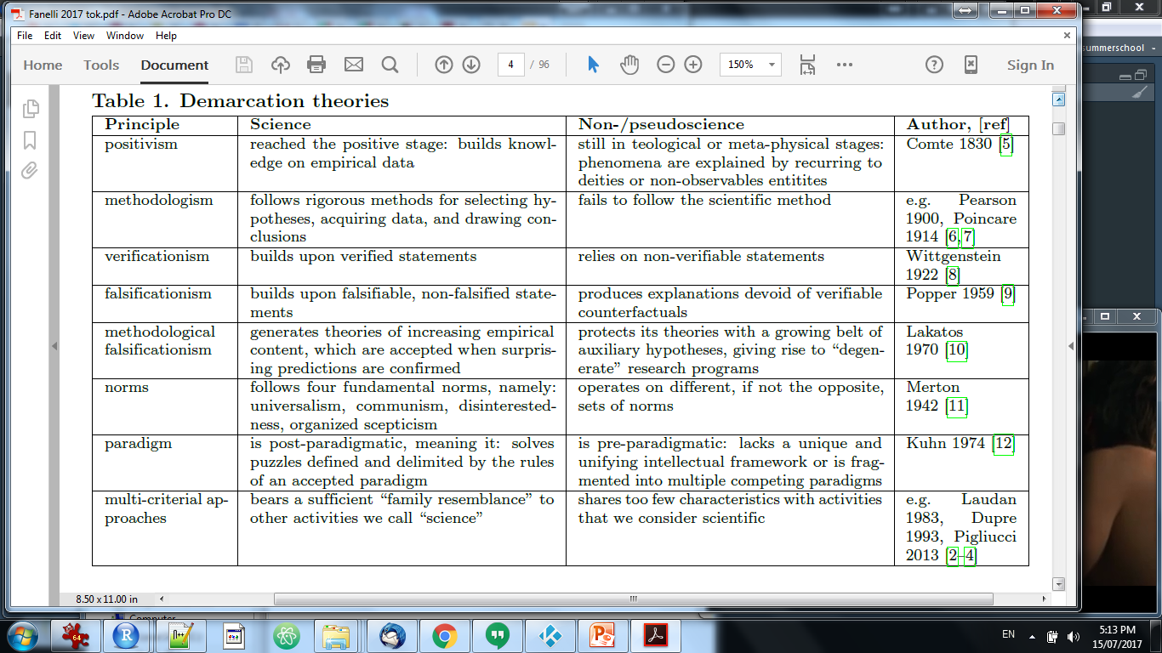
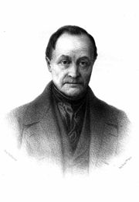
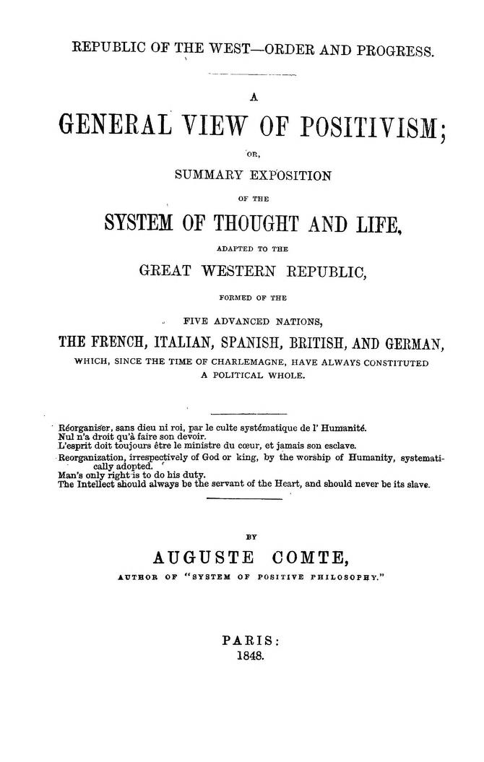
Notes:
First philosopher of science, suggested a hierarchy of science, a thing is a science if it depends on some higher science, stopping at math. Invented social science

Slide 6
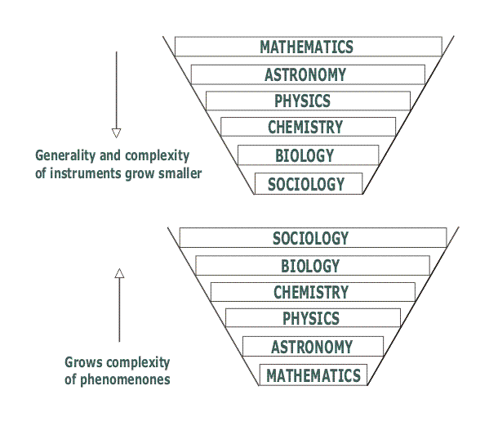

Slide 7
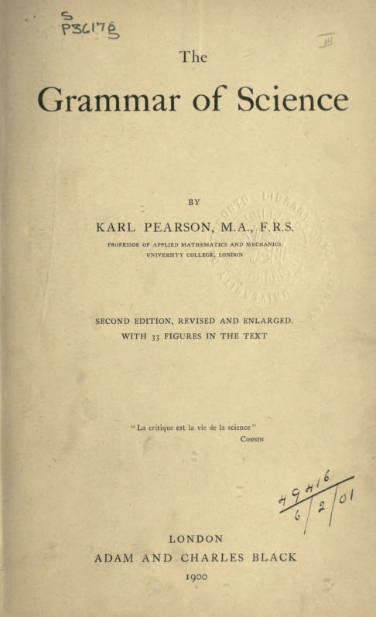
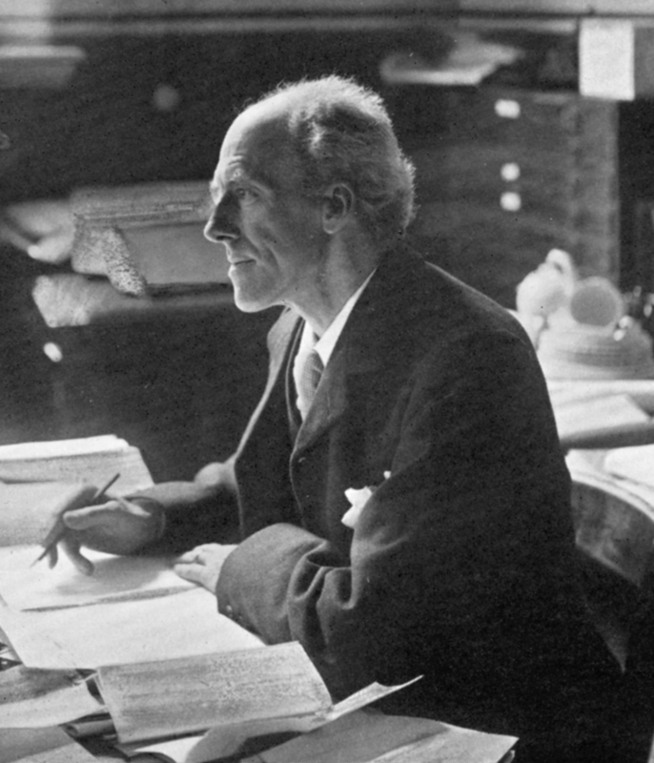
Notes:
Pearson of Pearson’s correlation coefficient, founder of mathematical statistics. Also into social Darwinism and eugenics. This book was a favourite of the young Einstein. Says that “The scientific method has the following distinctive features: (a) careful and accurate measurement of data, and "observation of their correlation and sequence“…”

Slide 8
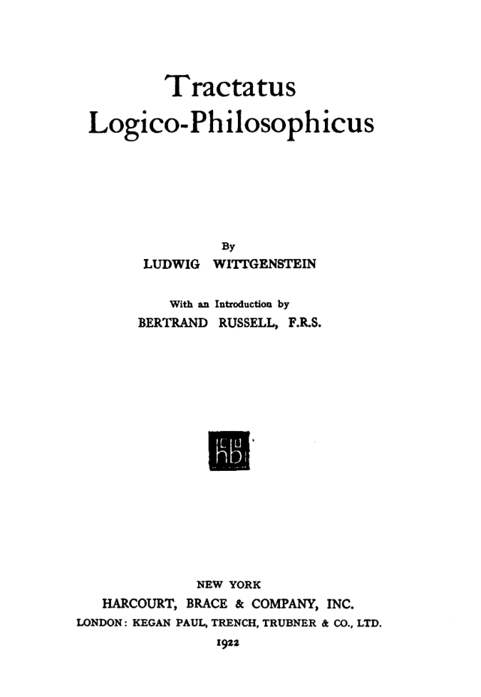
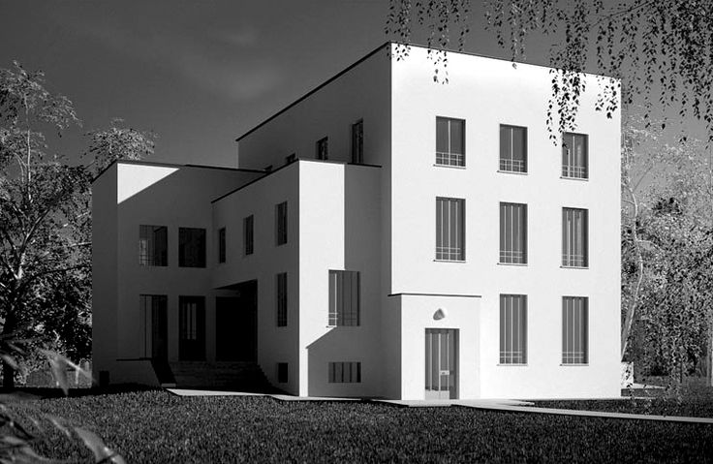
Notes:
as a particular type of language game… Only statements that are empirically verifiable (i.e. verifiable through the senses) are cognitively meaningful, or else they are truths of logic (tautologies). “every meaningful proposition must be logically reducible to elementary (or atomic) propositions, which he characterizes as
descriptions or ‘pictures of reality’.

Slide 9
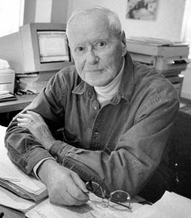
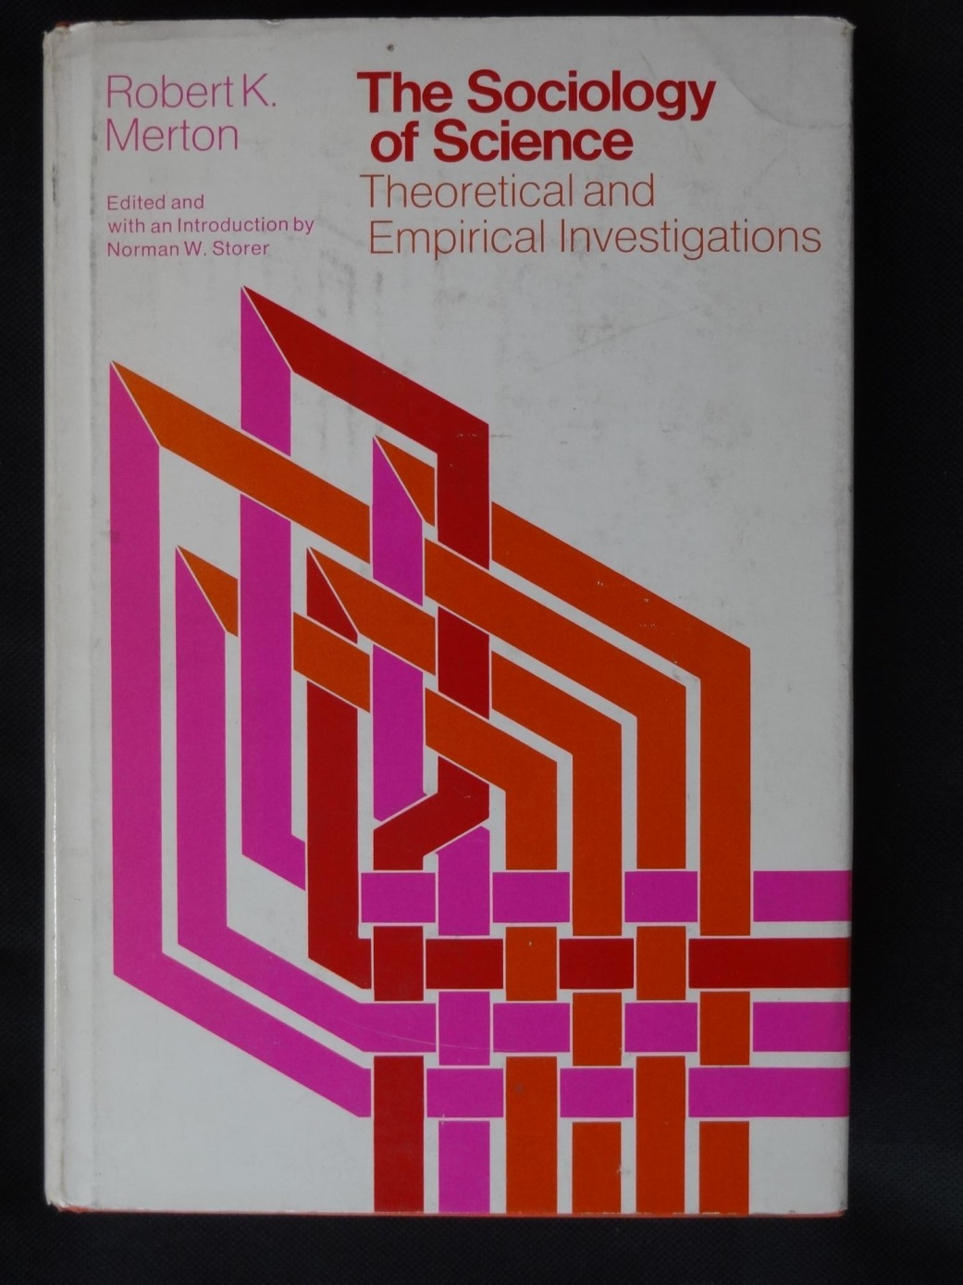
Notes:
Invented the focus group after radios became common in homes in the US. established sociology as a major scientific discipline, "Matthew effect“ etc. Mismatch of norms with reality is a major source of personal stress.
CUDOS: universalism: scientific validity is independent of the sociopolitical status/personal attributes of its participants. “communalism”: all scientists should have common ownership of scientific goods (intellectual property), to promote collective collaboration; secrecy is the opposite of this norm. disinterestedness: scientific institutions act for the benefit of a common scientific enterprise, rather than for the personal gain of individuals within them organized scepticism: scientific claims should be exposed to critical scrutiny before being accepted: both in methodology and institutional codes of conduct

Slide 10
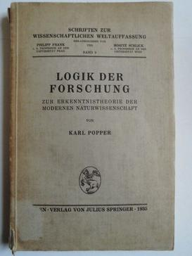
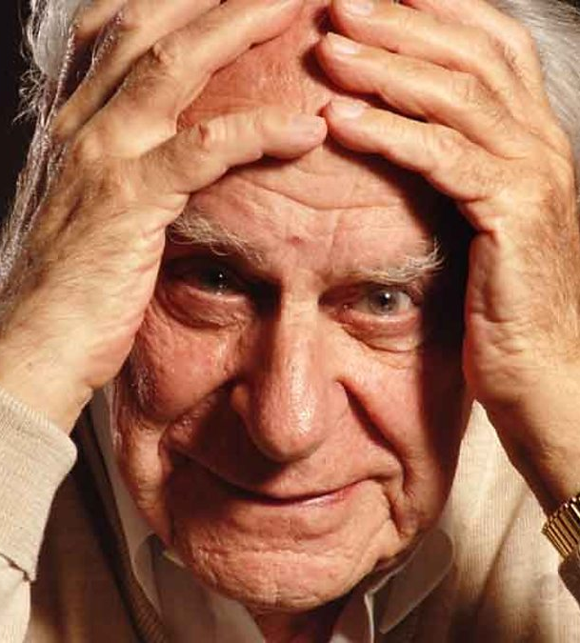
Notes:
Rejected verifiability as a criterion for a scientific theory or hypothesis to be scientific, rather than pseudoscientific or metaphysical. Instead he proposed as a criterion that the theory be falsifiable, or more precisely that “statements or systems of statements, in order to be ranked as scientific, must be capable of conflicting with possible, or conceivable observations”
Popper’s demarcation criterion concerns the logical structure of theories.
Popper’s demarcation criterion has been criticized both for excluding legitimate science and for giving some pseudosciences the status of being. Strictly speaking, his criterion excludes the possibility that there can be a pseudoscientific claim that is refutable.

Slide 11
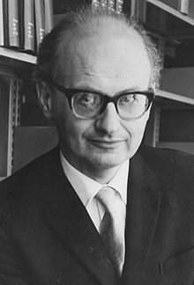
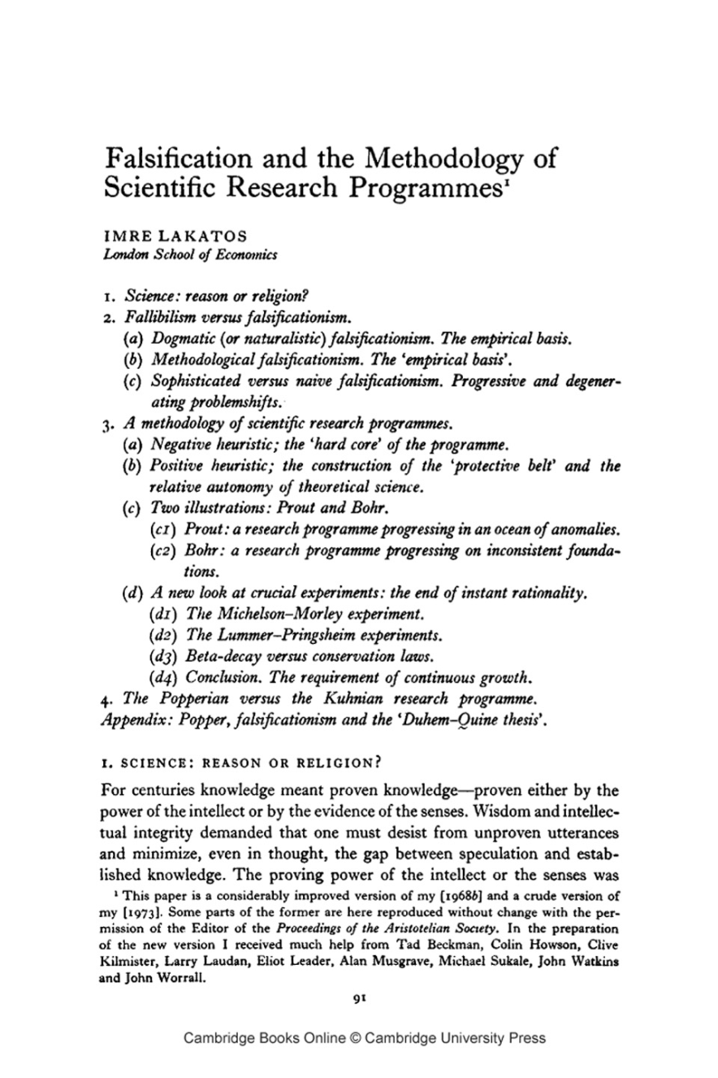
Notes:
Upset with Popper’s demarcation criterion concerns the logical structure of theories because Popper does not require evidence. Sophisticated (methodological) falsificationism: a theory is pseudoscientific if it fails to make any novel predictions of previously unknown phenomena, in contrast with scientific theories, which predict novel fact(s).

Slide 12
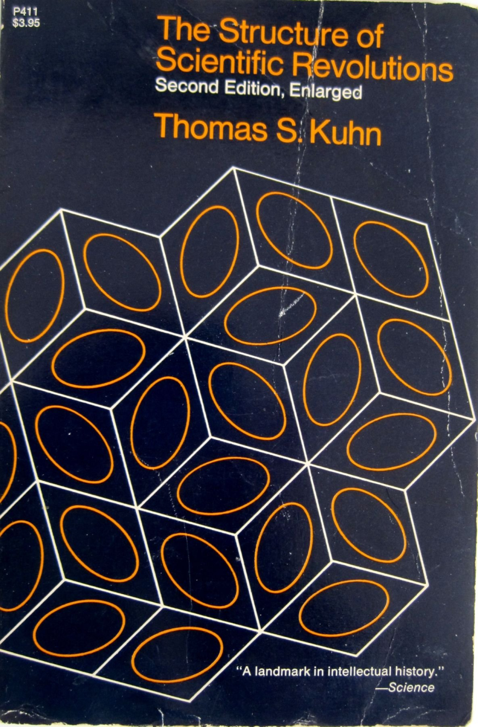
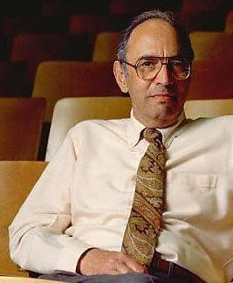
Notes:
Disagree with Popper; The criterion of puzzle-solving: Kuhn’s view of demarcation is most clearly expressed in his comparison of astronomy with astrology. Since antiquity, astronomy has been a puzzle-solving activity and therefore a science. If an astronomer’s prediction failed, then this was a puzzle that he could hope to solve for instance with more measurements or with adjustments of the theory. In contrast, the astrologer had no such puzzles since in that discipline

Slide 13
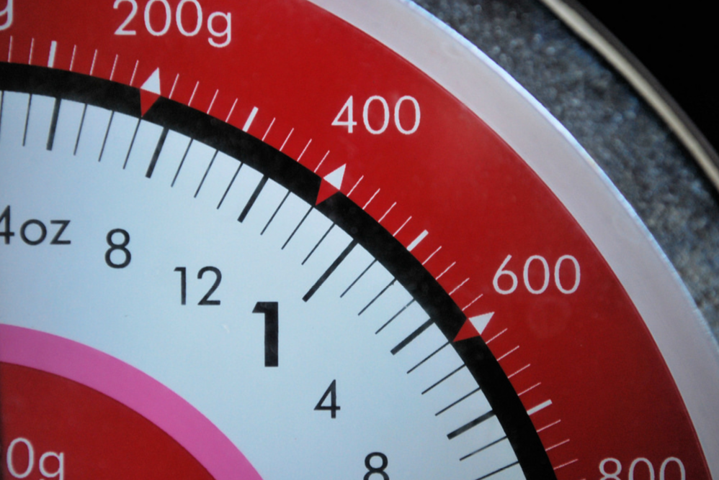
But these approaches have limited practical value

Slide 14
But these approaches have limited practical value
a research program (Lakatos)
an epistemic field or cognitive discipline (Bunge)
a theory (Popper)
a practice (Lugg; Morris)
a scientific problem or question (Siitonen)
a particular inquiry (Kuhn; Mayo)
individual
group
institute
discipline

Slide 15
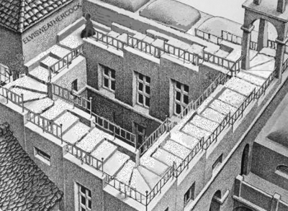
The demarcation paradox
Notes:
The approaches for determining what is and is not a science, are themselves not very scientific. Cherry-picking isolated examples, uncontrolled, not empirical

Slide 16
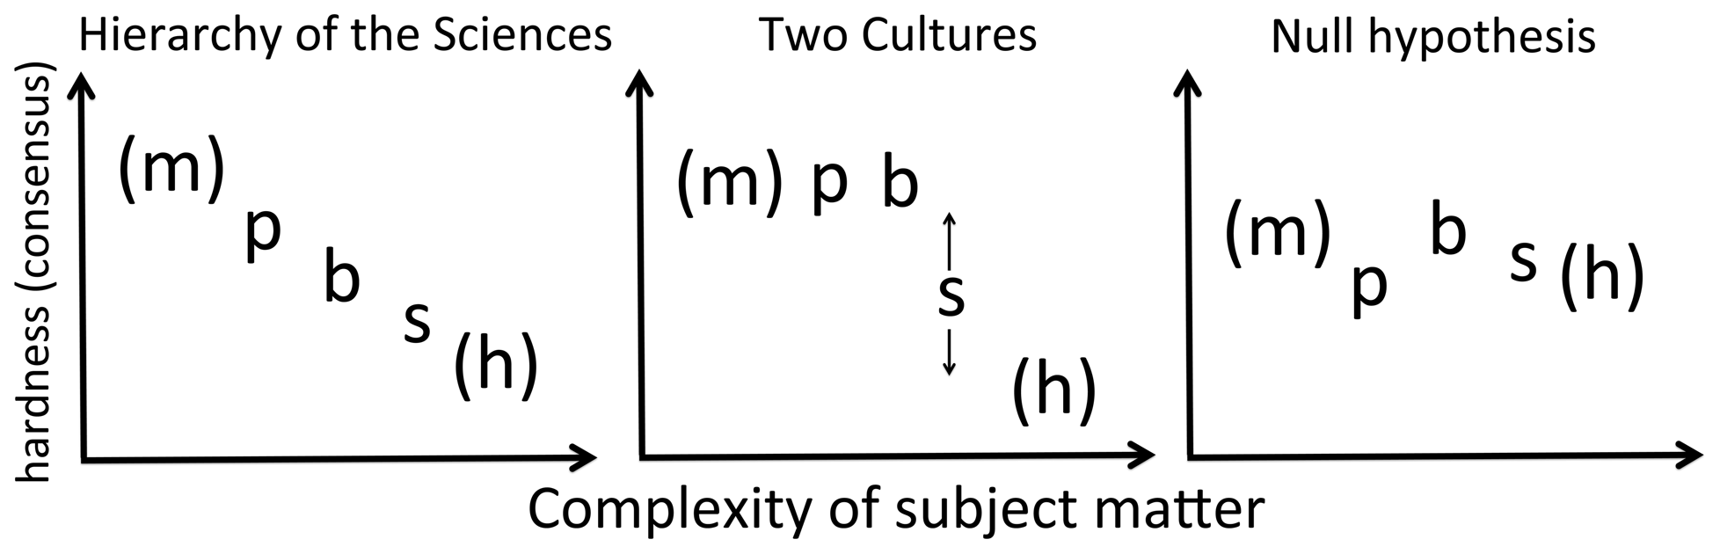
How can we be scientific about scientific demarcation?
Notes:
Going back to Comte, we can proposed a hypothesis of an hierarchy of the sciences that we can test quantitatvly

Slide 17
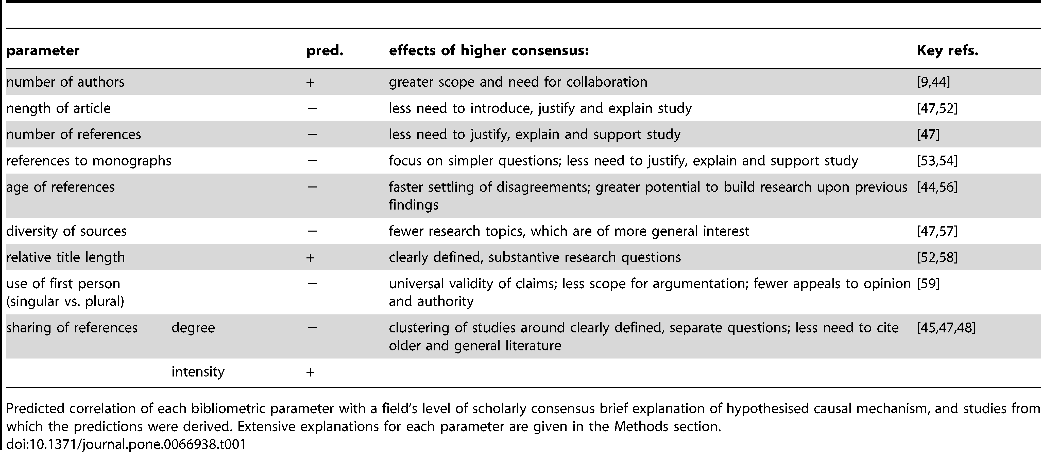

Bibliometric Evidence for a Hierarchy of the Sciences?
Fanelli D, Glänzel W (2013) Bibliometric Evidence for a Hierarchy of the Sciences. PLOS ONE 8(6): e66938. https://doi.org/10.1371/journal.pone.0066938
Notes:
So let’s see what scientists actually do, and them compare how archaeology fits in

Slide 18
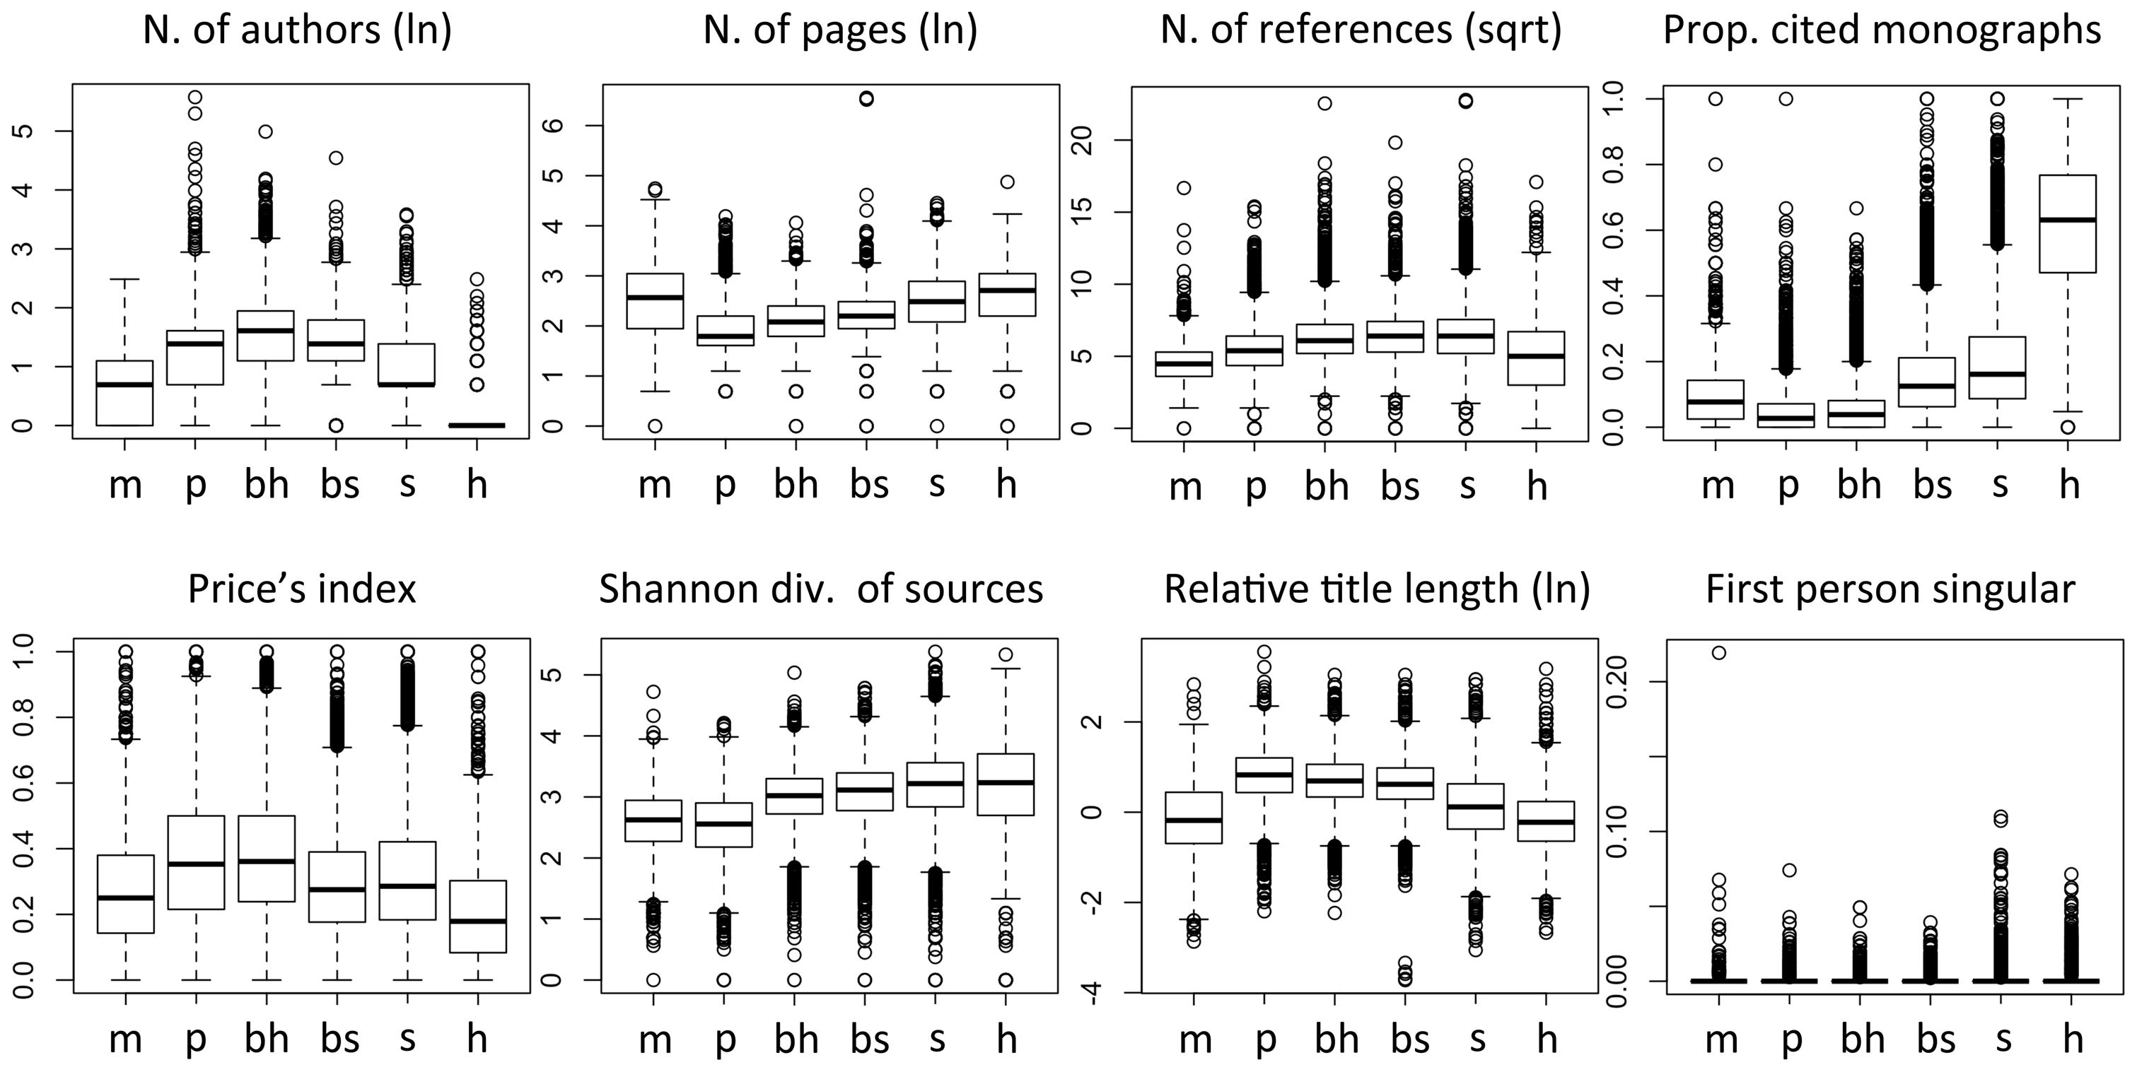
Notes:
29,000 papers published at the beginning of 2012 in journals that Thomson Reuters’ Essential Science Indicators (ESI)

Slide 19
Notes:
29,000 papers published at the beginning of 2012 in journals that Thomson Reuters’ Essential Science Indicators (ESI)

Slide 20
Where does archaeology fit?

Slide 21
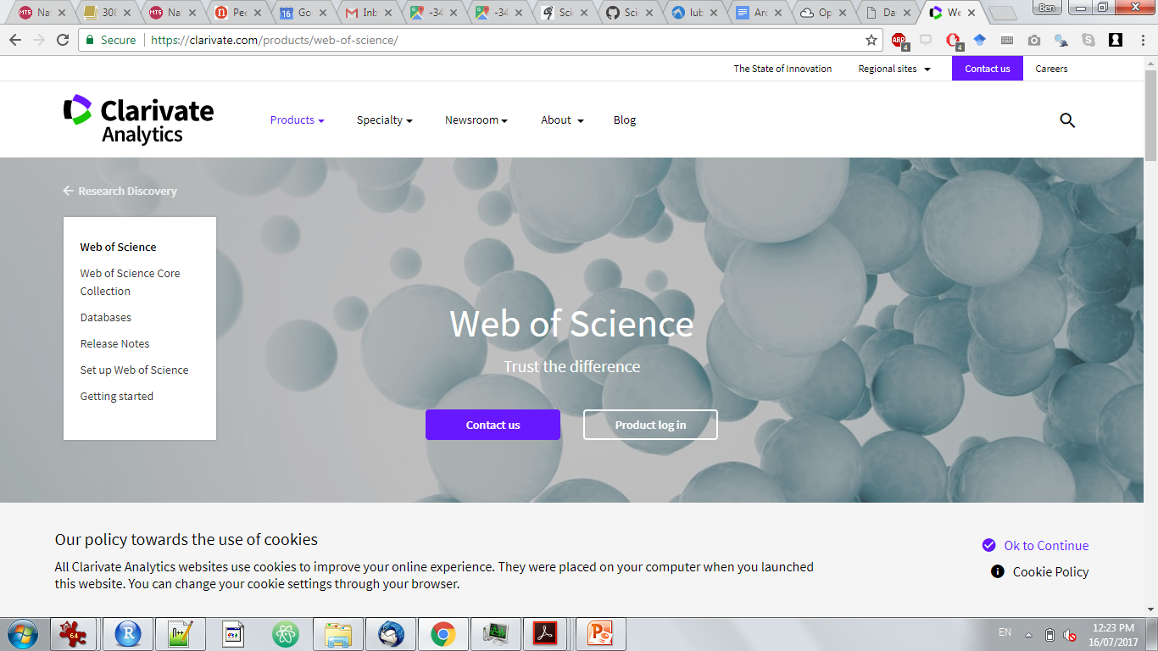
~8000 Archaeology journal articles published 2010-2016, indexed on the Web of Science

Slide 22
Notes:
Research teams are almost by definition built around a consensus on objectives and methods. Moreover, the ability to study a problem with greater accuracy and detail leads to a specialization of roles, making collaboration essential [9]. The hardness of a field, therefore, should be manifest
in the size of its research teams. Alternative arguments would suggest that team size is a consequence of funding availability, rather than consensus per se

Slide 23
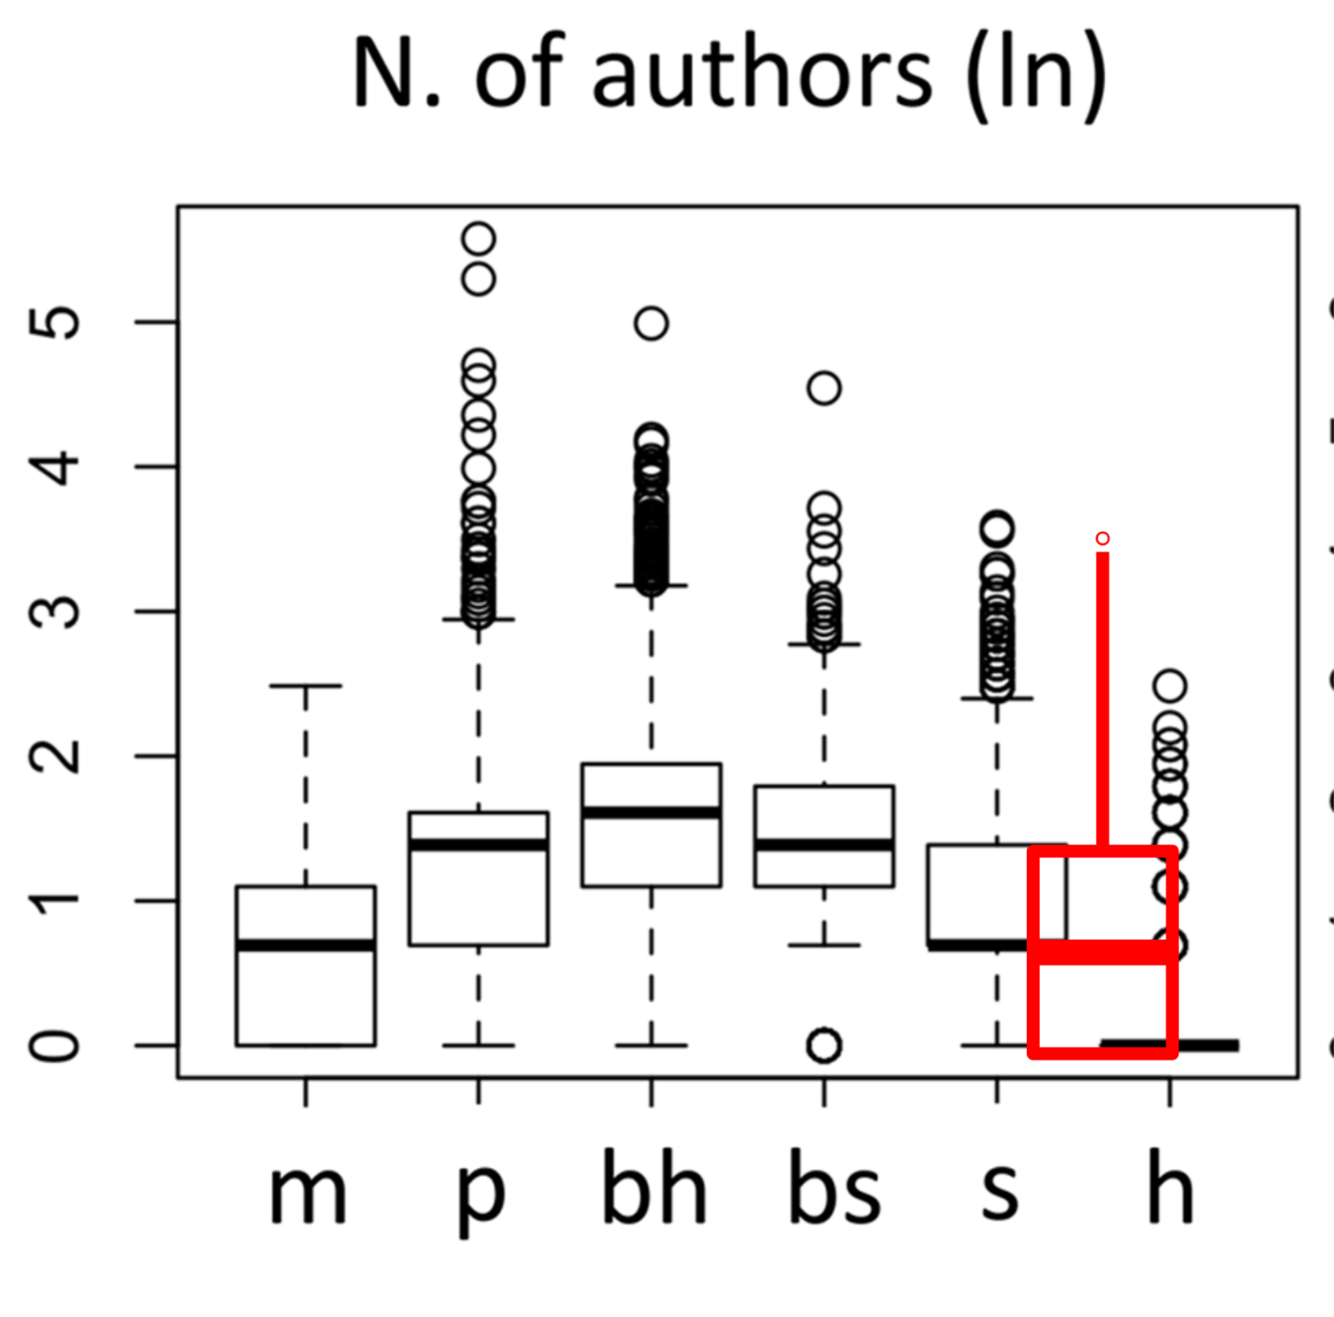

Slide 24
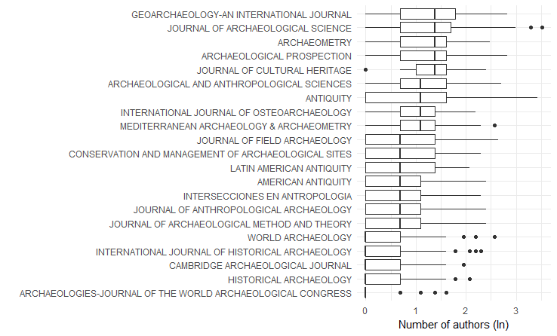

Slide 25
Notes:
When consensus is lower, papers must put greater efforts in describing the background, justify their rationale
and approach, back up their claims and extensively discuss their findings [47,52]. Longer introductions, and generally longer
papers, should therefore characterize softer research. We measured the total number of pages

Slide 26
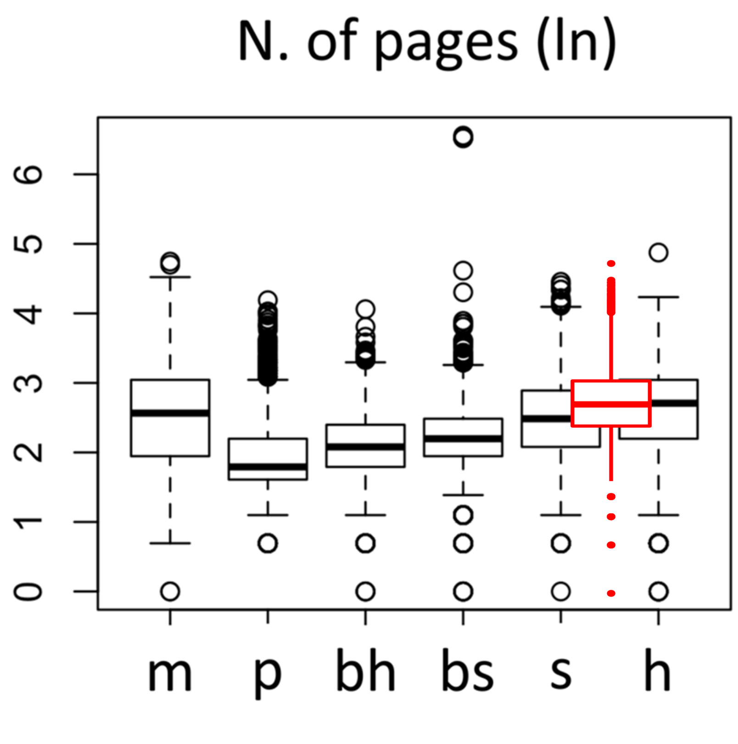

Slide 27
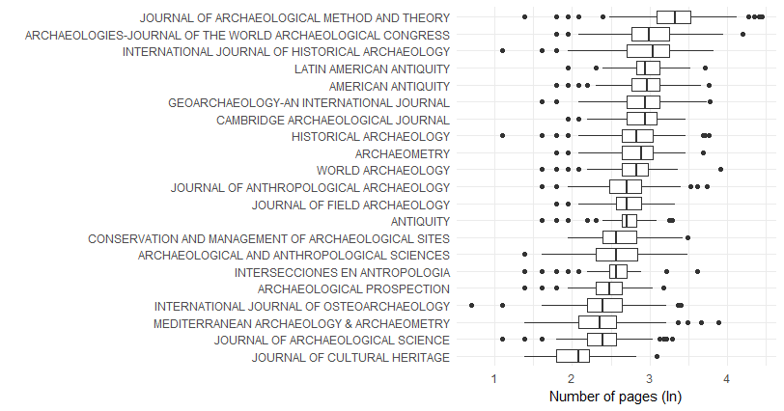

Slide 28
Notes:
Linguistic analyses of scientific papers noted that the number of substantive words in titles tended to be longer and to correlate with an article’s total length in harder fields [52,58]. This was interpreted as reflecting the greater empirical focus and efficiency of high-consensus fields, but the evidence was deemed too limited to draw firm conclusions. We measured the total number of words, divided by total number of pages.

Slide 29
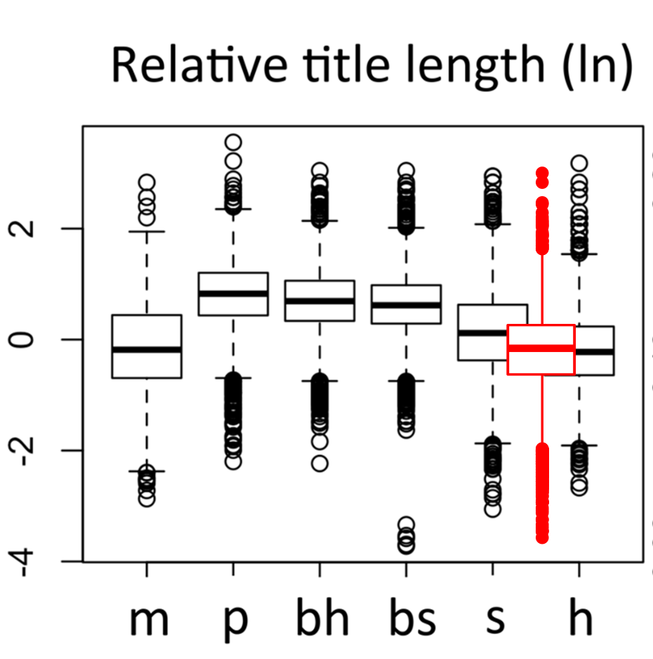

Slide 30
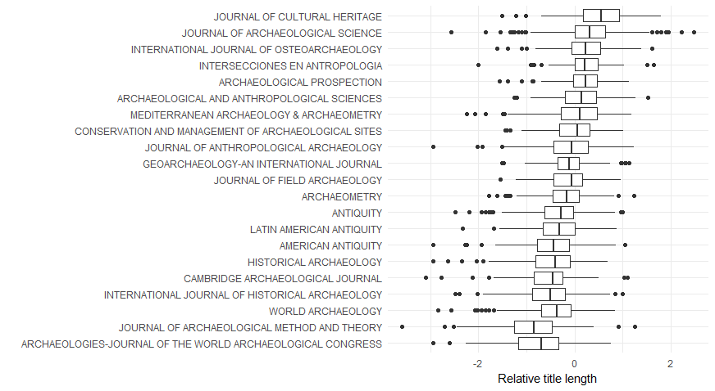

Slide 31
Notes:
For reasons similar to those that make an article longer, references to previous literature should also
be more numerous in low-consensus fields [47].

Slide 32
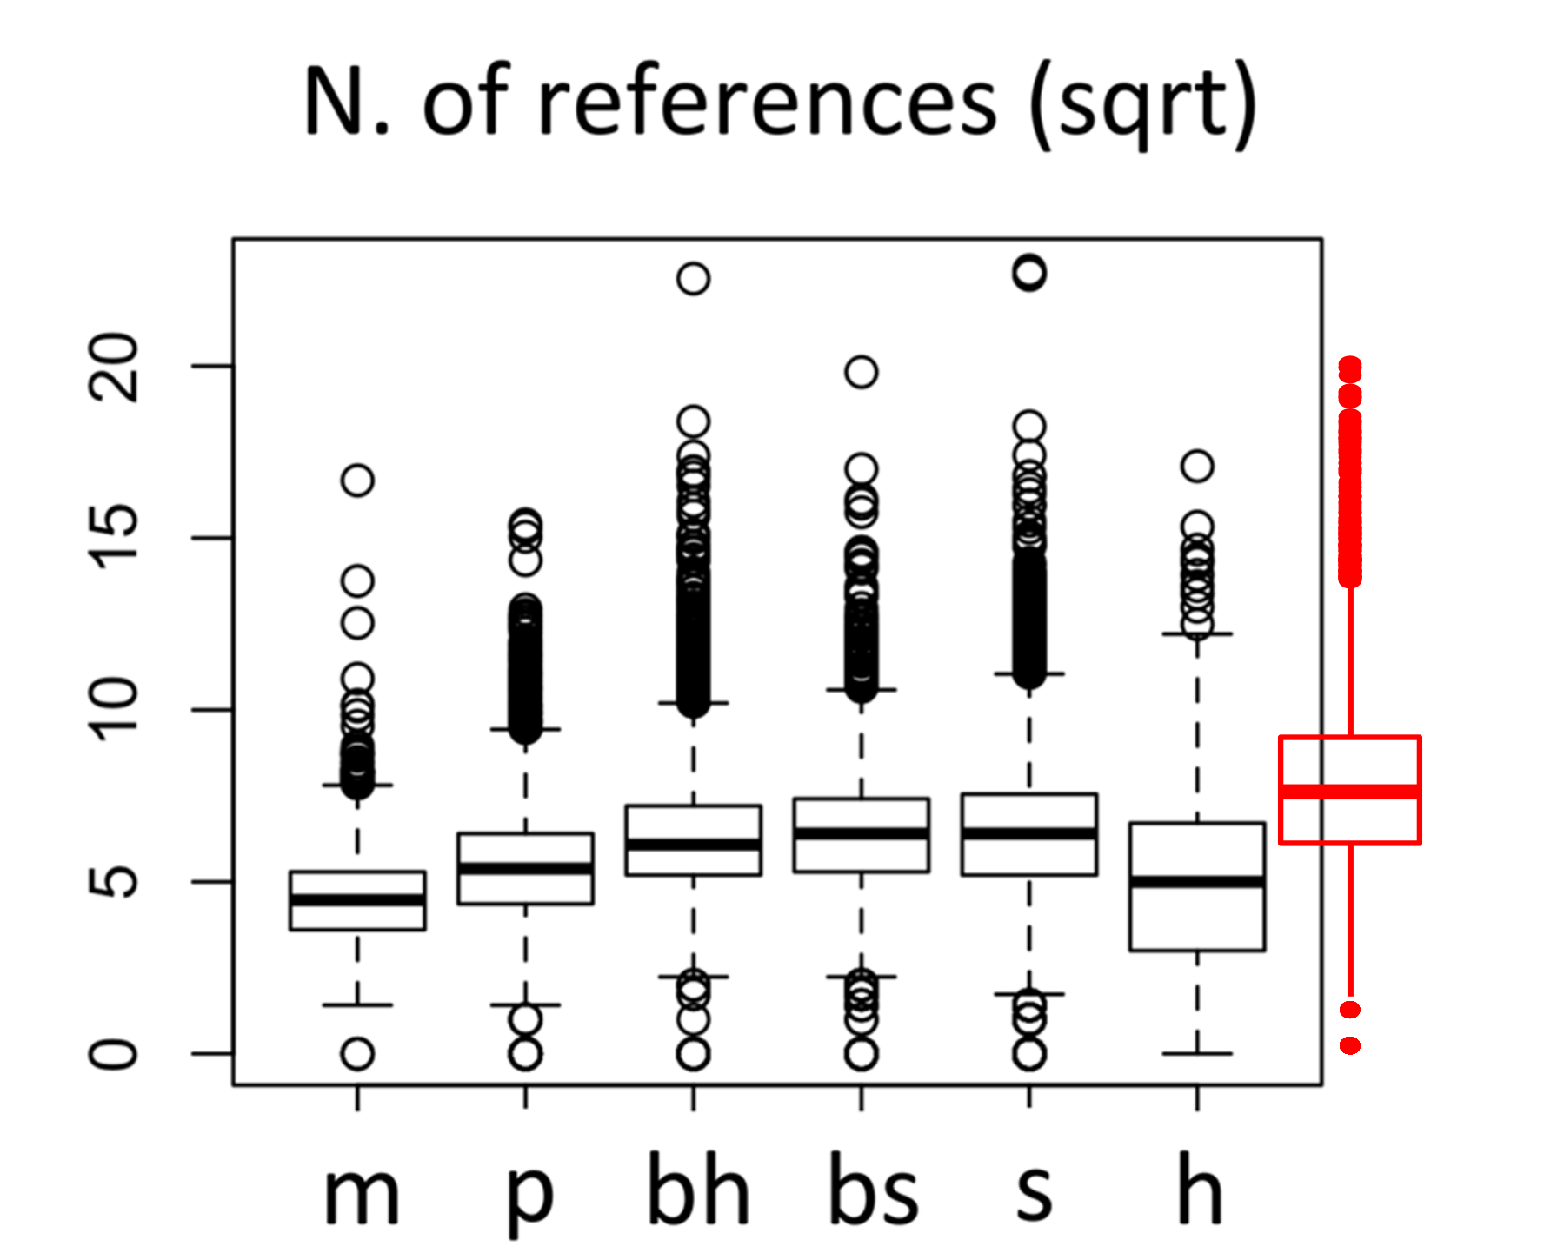

Slide 33
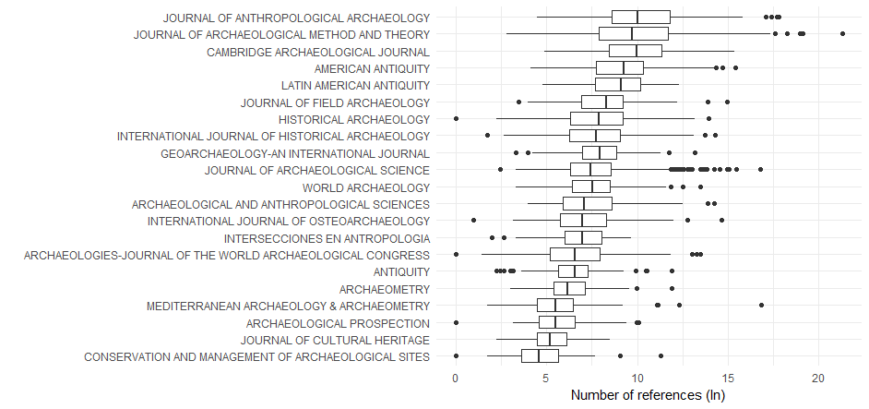

Slide 34
Notes:
Having noted that some sciences ‘‘metabolize’’ the literature more rapidly, Derek de Solla Price proposed an index, which measures the proportion of cited references published in the five years preceding the citing paper [44]. This index was repeatedly shown to distinguish the social and
natural sciences, and is therefore considered the measure of hardness (e.g. [55]).

Slide 35
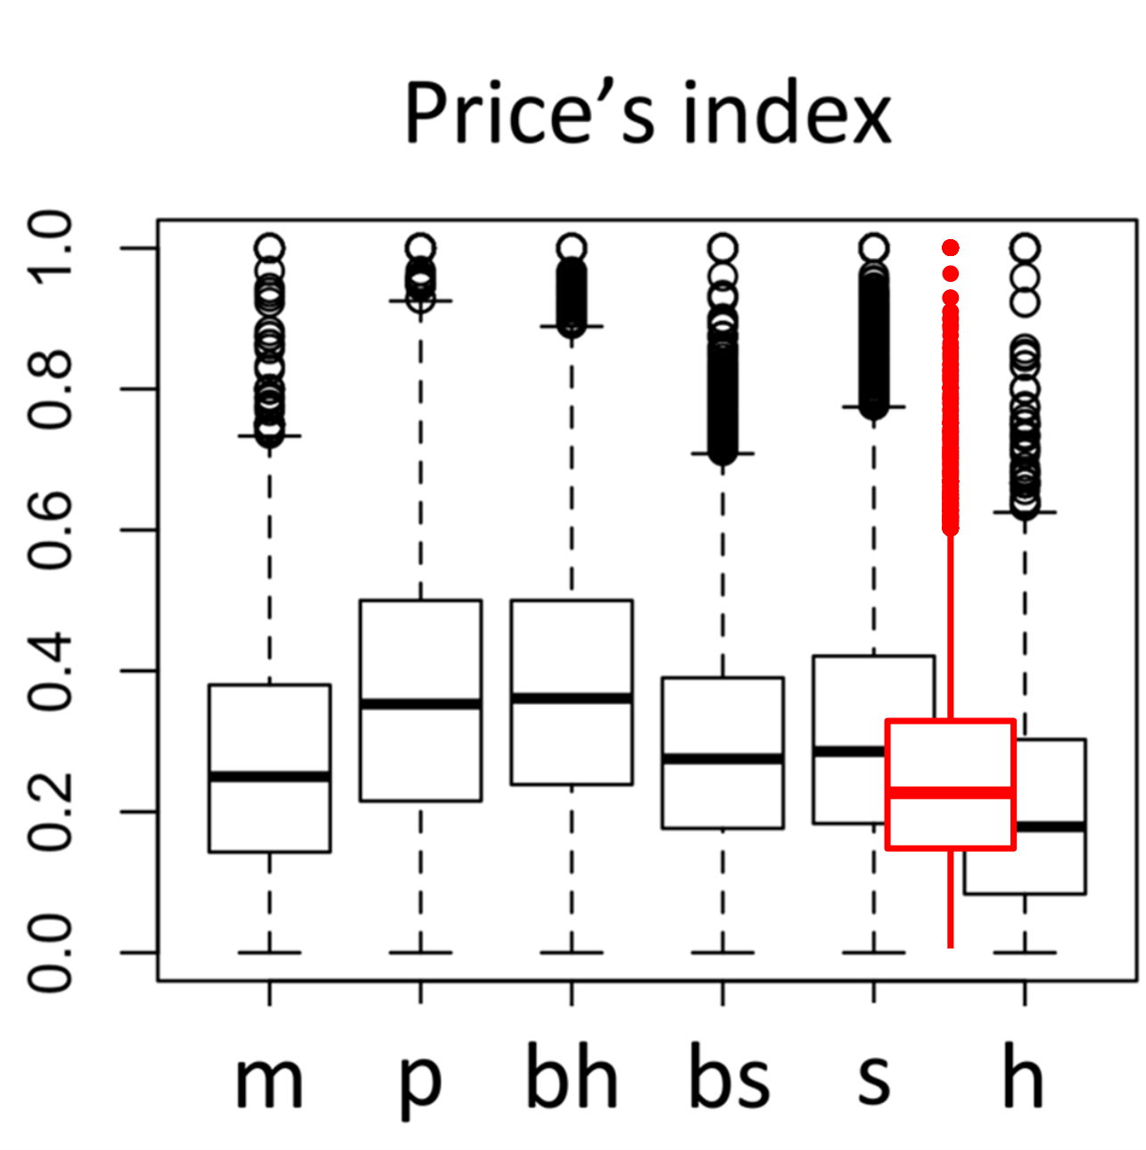

Slide 36
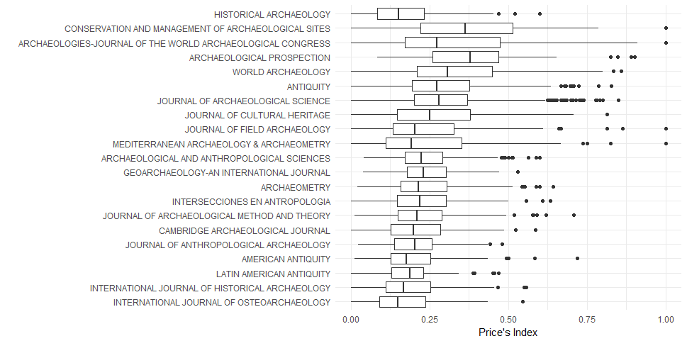

Slide 37
Notes:
When scholars agree on the relative importance of scientific problems, their efforts will concentrate in specific fields and their findings will be of more general interest, leading to a greater concentration of the relevant literature in few, high-ranking outlets. From harder to softer fields, therefore, we predict a growing diversity of sources of information [47]. Our

Slide 38
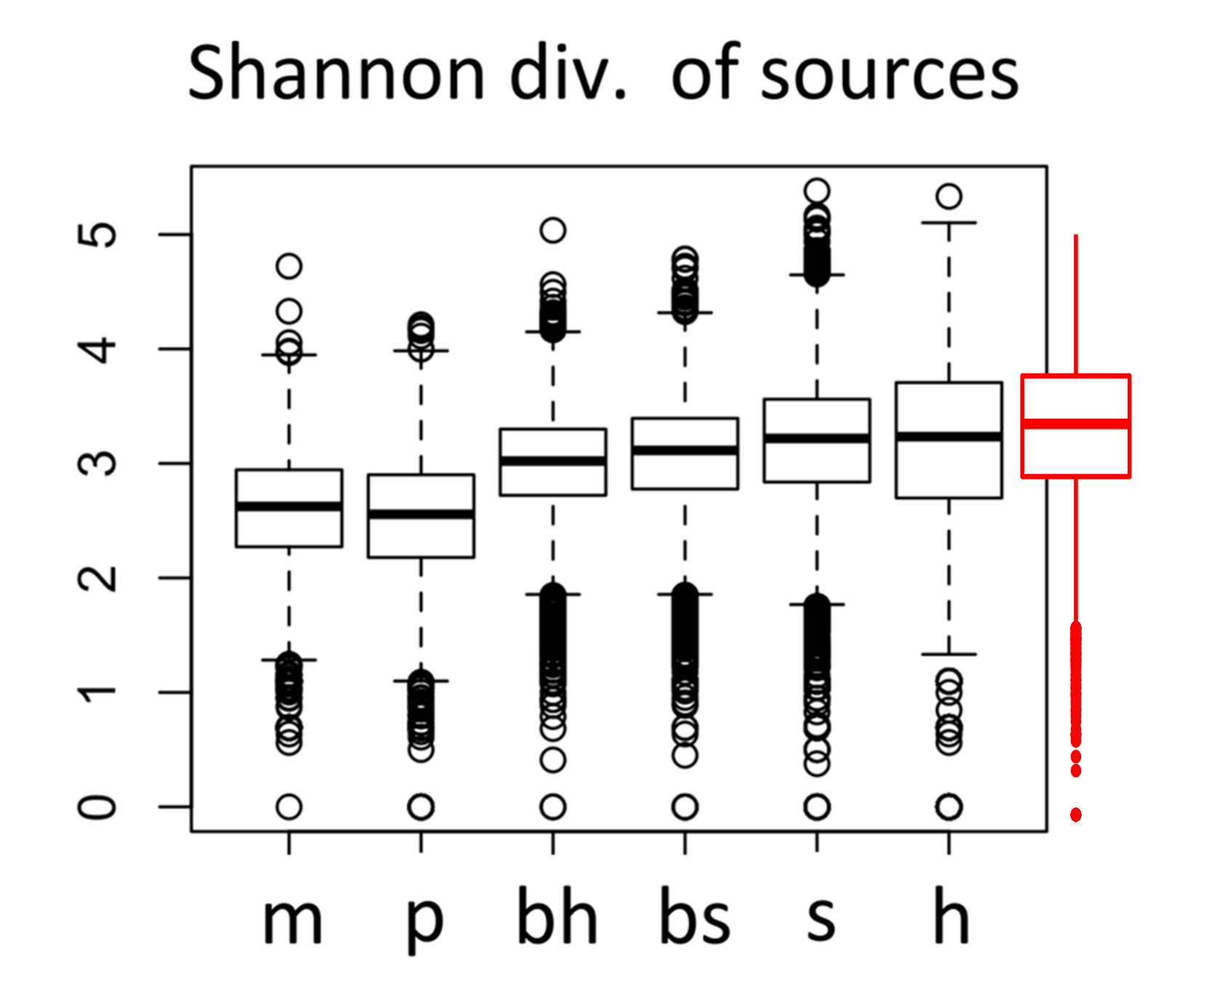

Slide 39
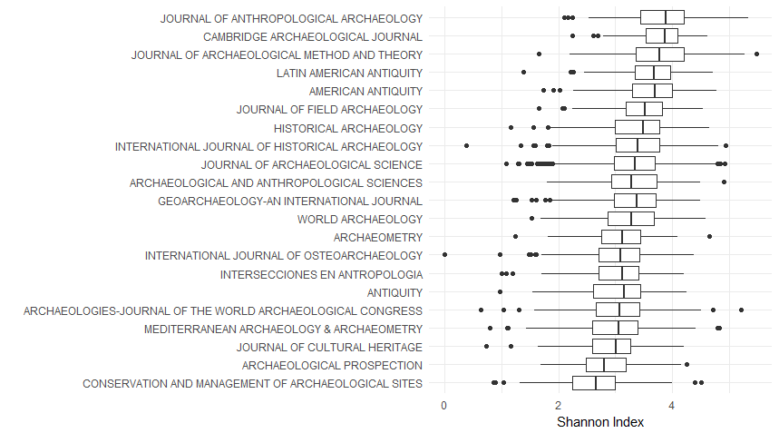

Slide 40
Bibliometric analysis indicates that archaeology is not much like a science.
By most measures it is between social science and humanities
And by some measures, less like a science than the humanities!
Notes:
Because we work in isolated groups, and have a strong culture of privacy and individual data ownership. In short, we have a cultural attributes that stop us from being a science

Slide 41
Sidenote: What about change over time?

Slide 42
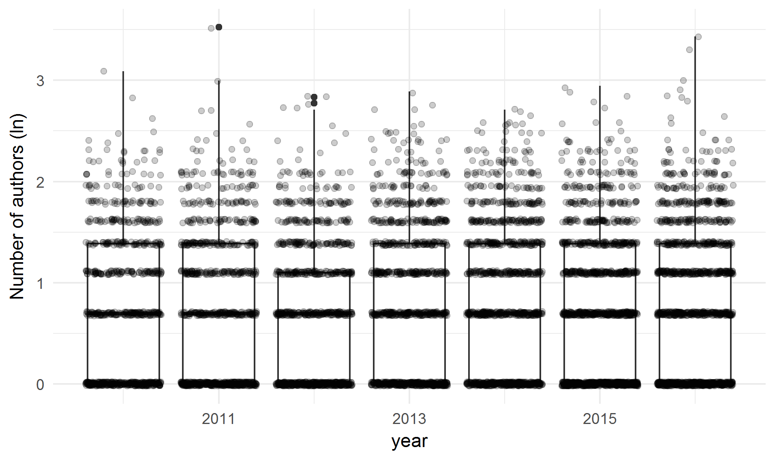
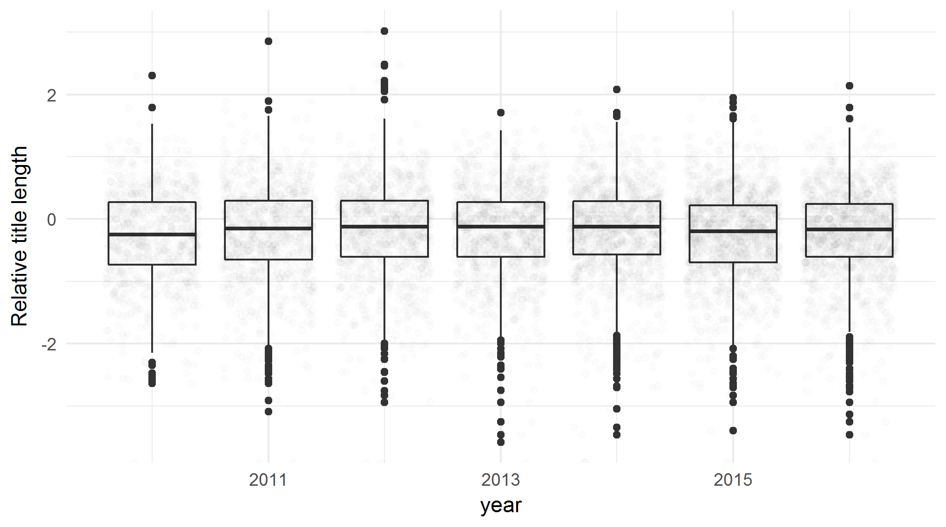
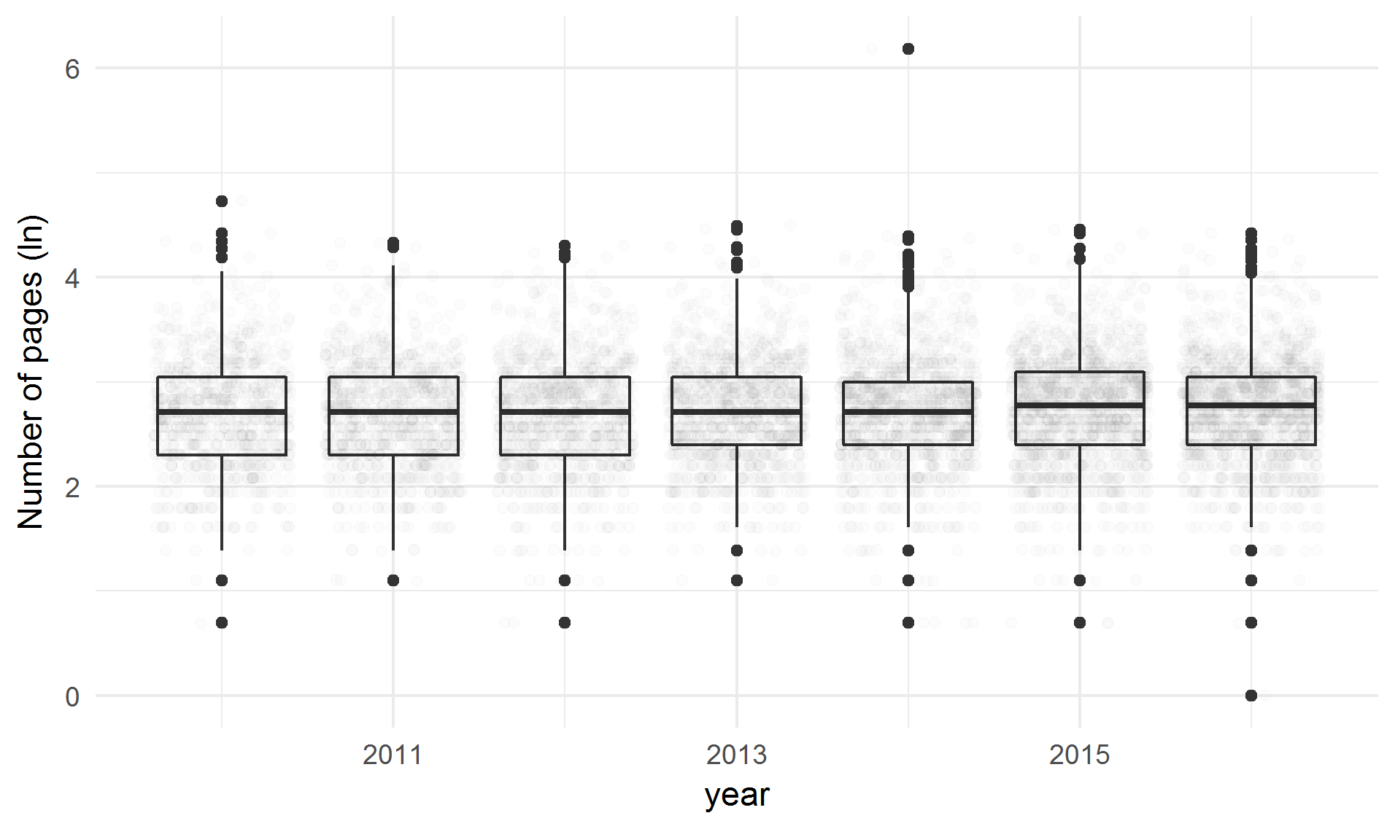
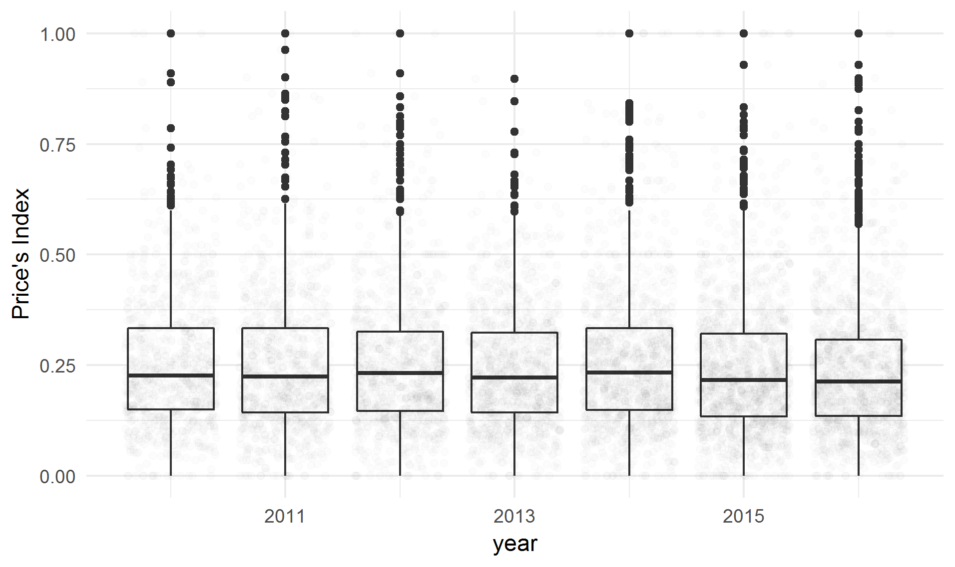
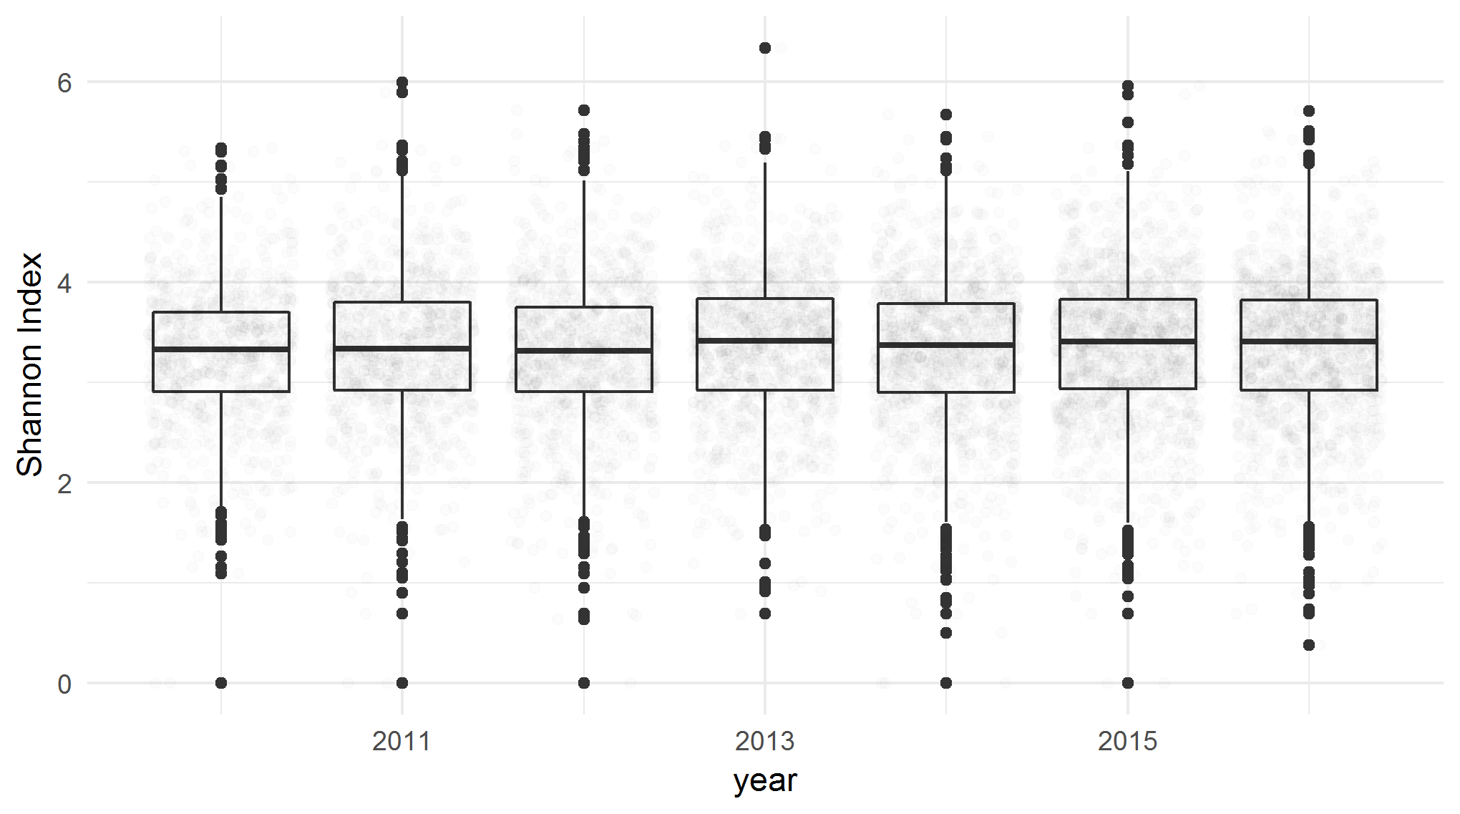
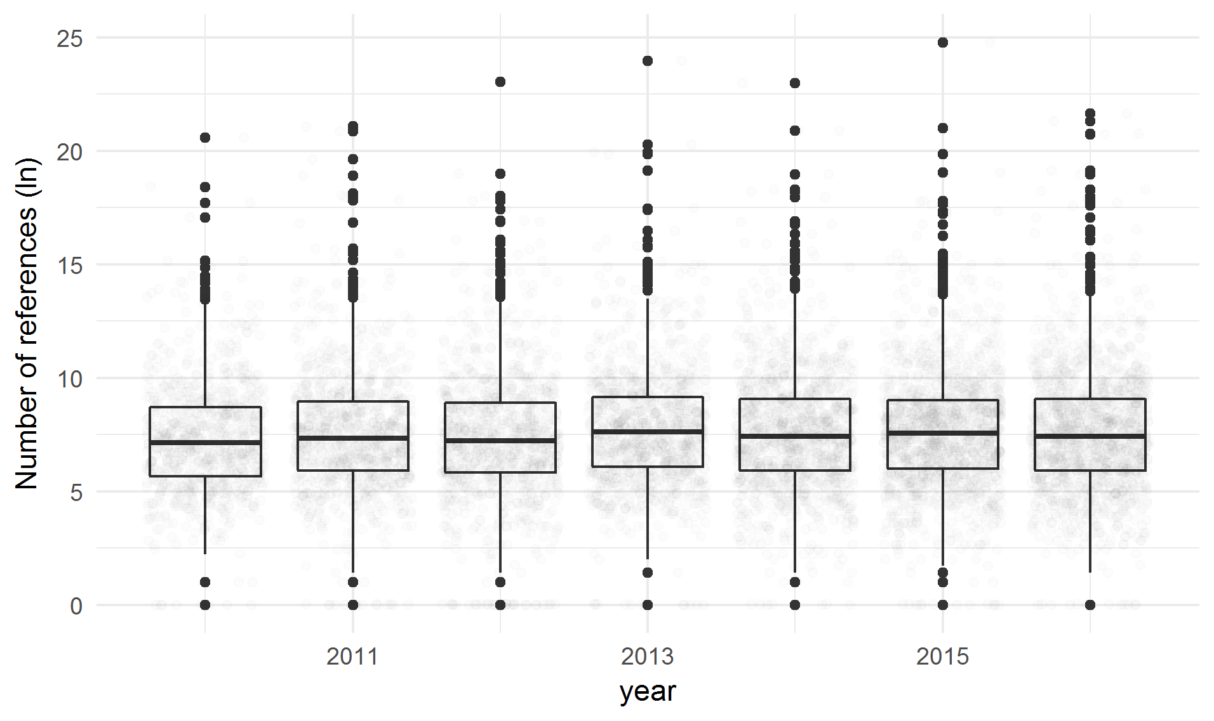

Slide 43

http://i.imgur.com/VjW99gR.gif

Slide 44
How to be a science
Notes:
http://onlinelibrary.wiley.com/doi/10.1111/j.1945-5100.1999.tb01388.x/epdf

Slide 45
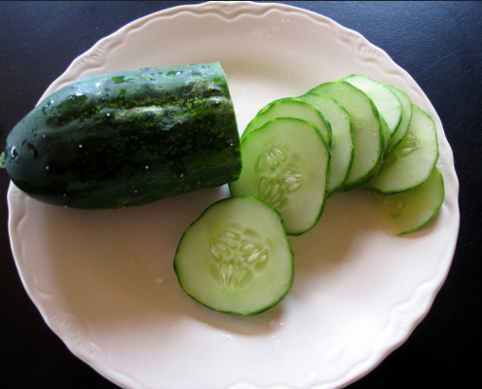

Slide 46
“Getting information from a table is like extracting sunlight from a cucumber”
Farquhar A. & B. Farquhar (1891) Economic and industrial delusions: A discourse of the case for protection. New York, Putnam
Notes:
This comment is an allusion to Gulliver’s travels, the topsy turvey world. The original meaning referred to tables in the late 19th C that were designed for data storage, not communication. So it was difficult to get information out of them, for example, where are the groups? what are the trends? We have a related problem in archaeology now.

Slide 47
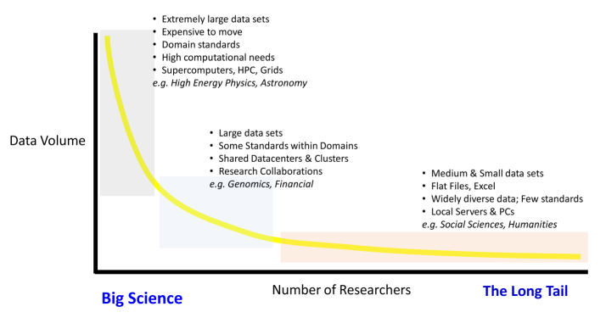
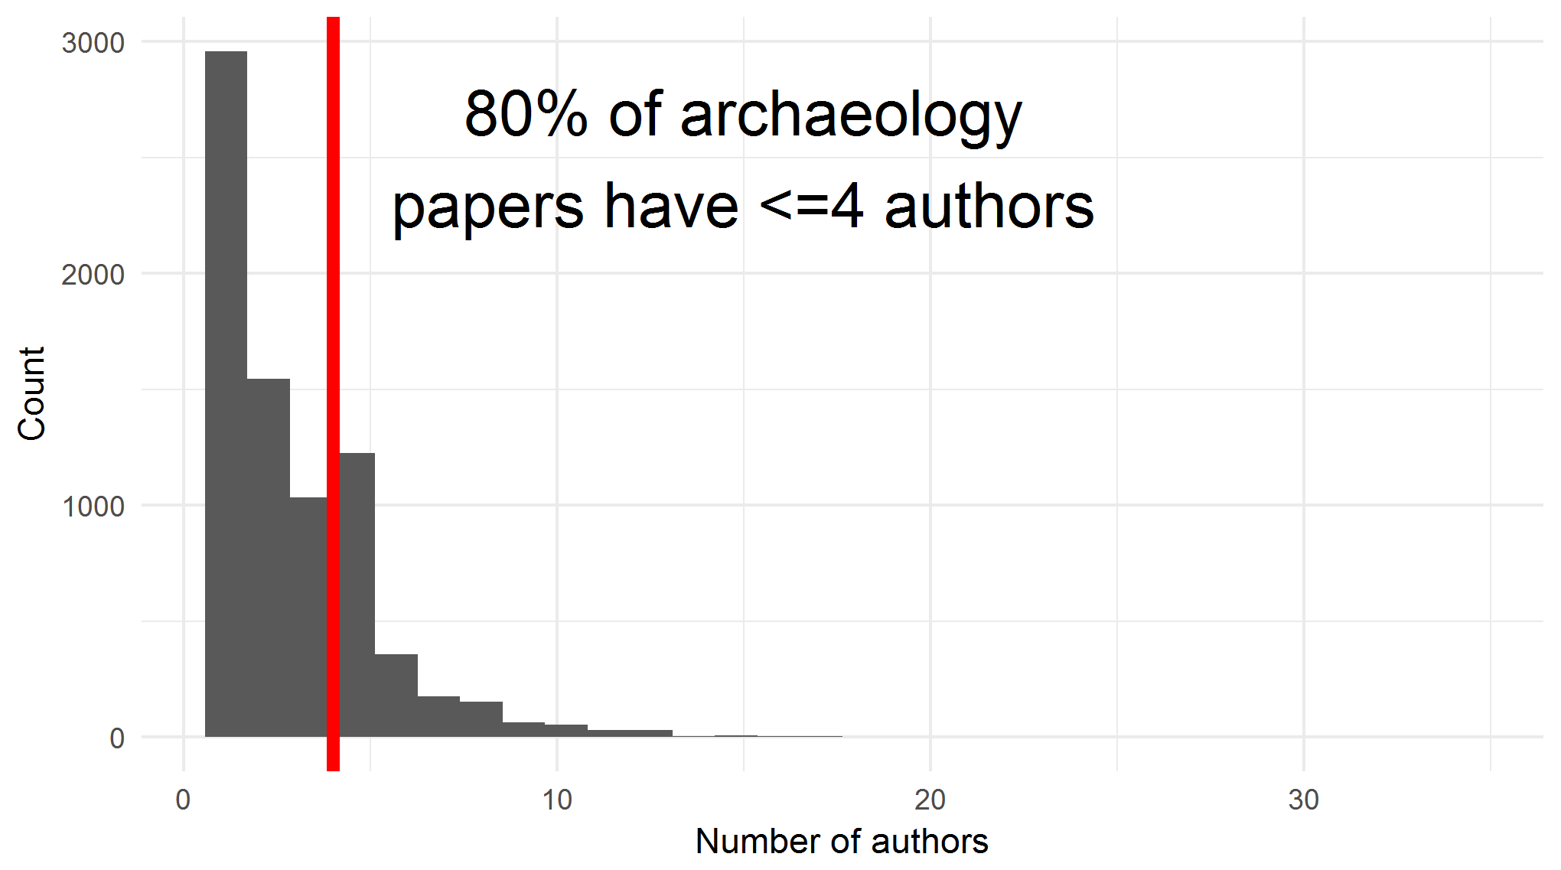
Bigger sciences have self-organised data sharing norms, standards, services and technologies
Notes:
Because they share an understanding that things are necessary for them to make progress in their field by making new predictions, and testing them

Slide 48
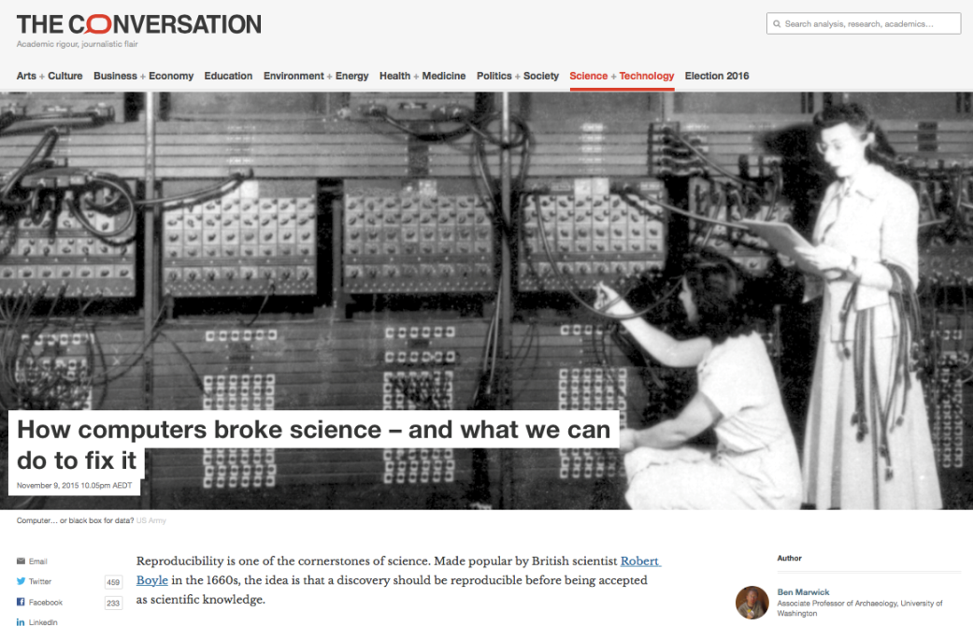
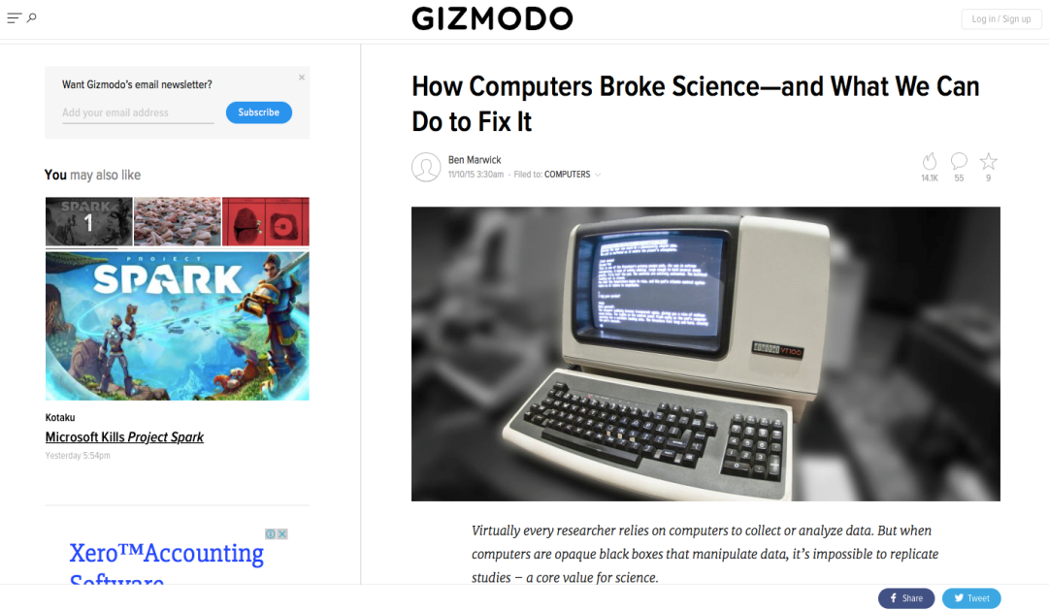
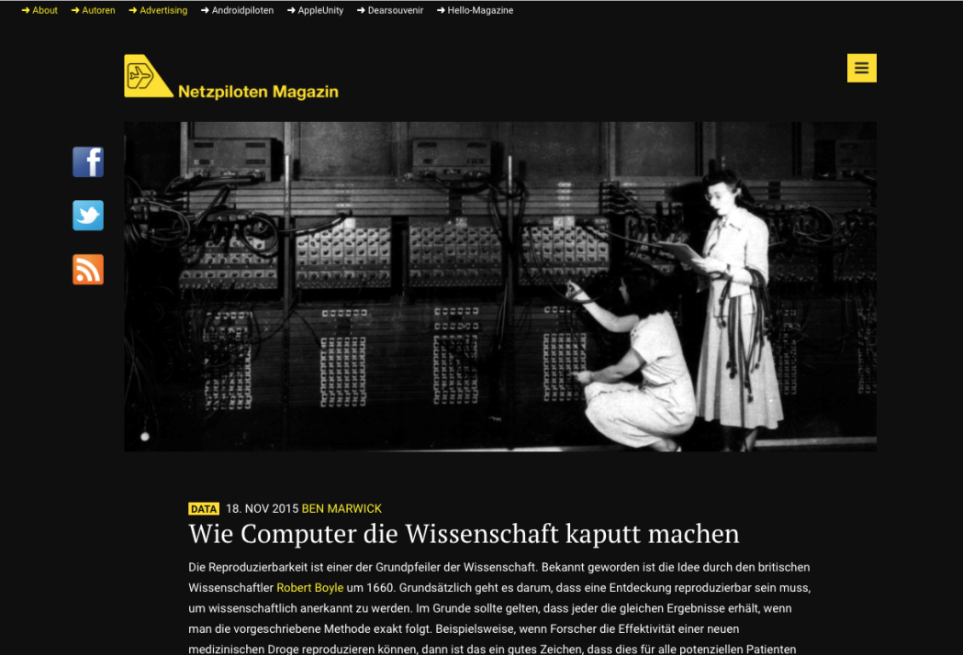
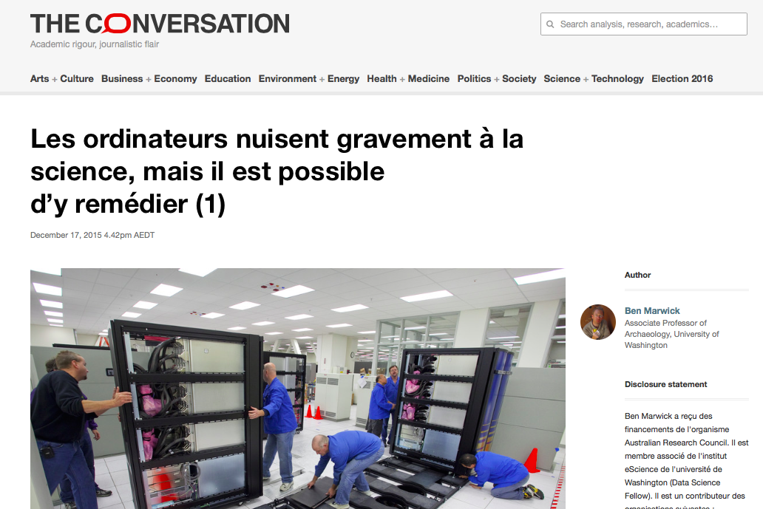

Slide 49
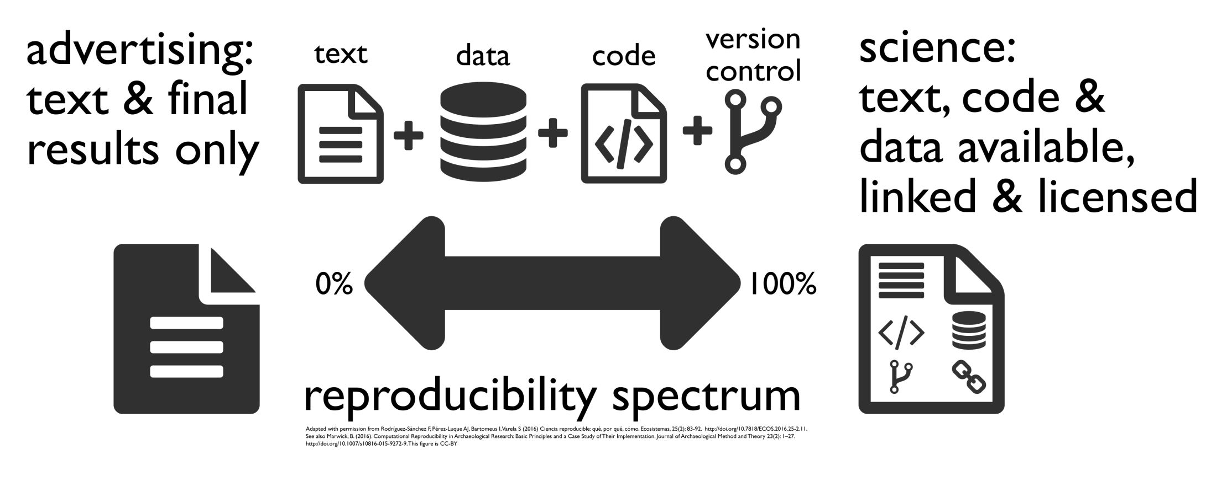
Marwick et al. submitted 2017 Open Science in Archaeology, “SAA Archaeological Record” bit.ly/OSIG-SAAAR

Slide 50
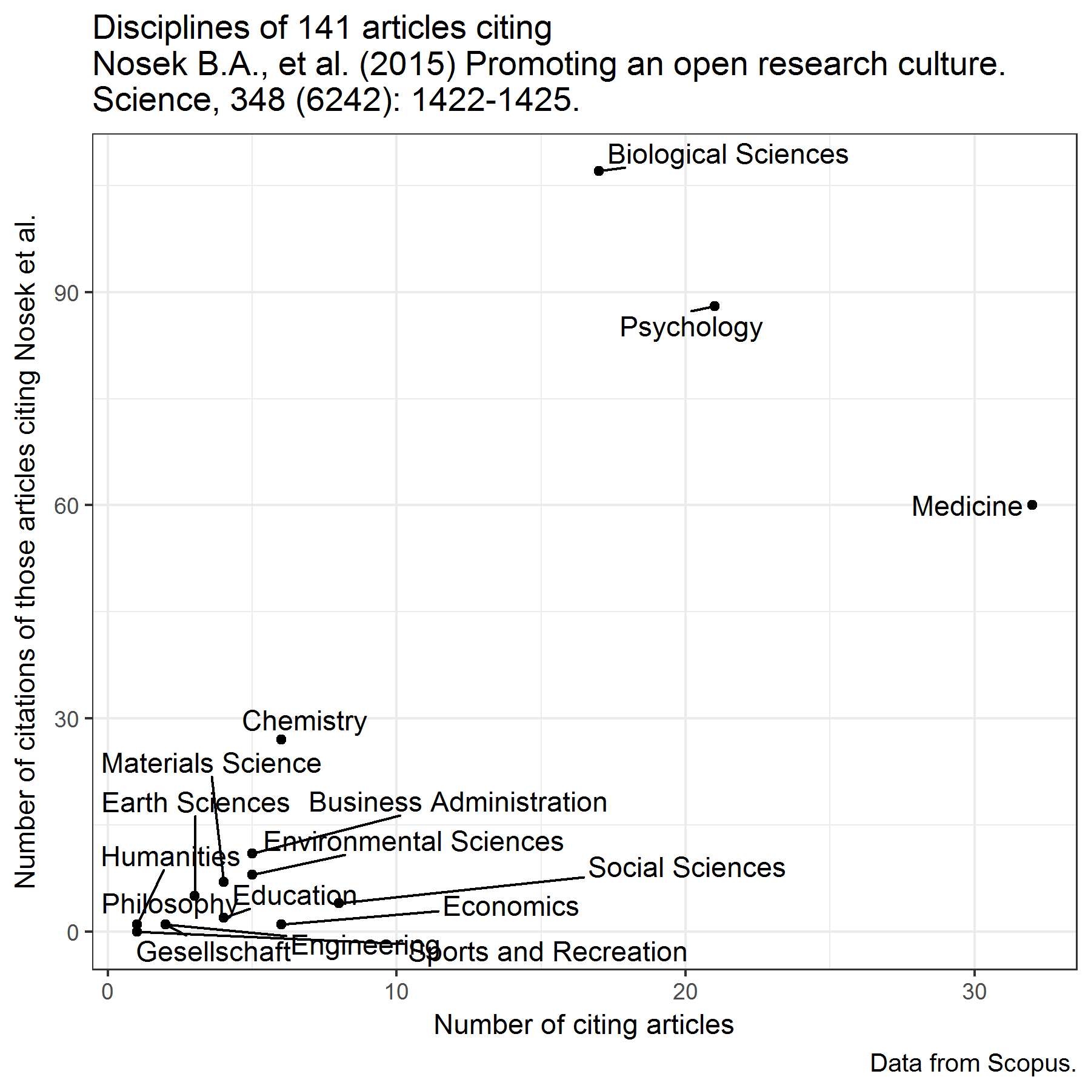
Work with Carole Lee on change in scientific cultures
Notes:
Code for this is here: https://gist.github.com/benmarwick/931a7ede38afd473825baface2f0b8b8

Slide 51

So, how can archaeology do it?

Slide 52


A tool-driven change will help archaeology become more like a science

Slide 53




Notes:
And here are the tools. We’ll be working on these over the next few days to get familiar with them to do real work.

Slide 54

Marwick et al. submitted 2017 Open Science in Archaeology, “SAA Archaeological Record” bit.ly/OSIG-SAAAR

Slide 55

Marwick, B. 2017. Using R and Related Tools for Reproducible Research in Archaeology. In Justin Kitzes, Daniel Turek, Fatma Deniz (eds) The Practice of Reproducible Research: Case Studies and Lessons from the Data-Intensive Sciences. University of California Press.
Notes:
Here’s how this new way of working fits into a typical archaeological research project. This is complicated, and some people have mentioned directly that it’s too much. So you might ask…

Slide 56
Is this sustainable?
Notes:
http://onlinelibrary.wiley.com/doi/10.1111/j.1945-5100.1999.tb01388.x/epdf

Slide 57









Slide 58


Slide 59

bit.ly/OSIG-SAAAR

Slide 60
1. What is a science?
2. Why isn’t archaeology a science?
3. How to be a science
Philosophers of science don’t agree about how to demarcate science and non-science
A bibliometric analysis shows that the way we communicate is unlike harder sciences. Because we value privacy & ownership more than other fields
A tool-driven revolution to enable transparency and openness. Cultural change in the research community

Slide 61

Marwick, Ben (2016). Computational reproducibility in archaeological research: Basic principles and a case study of their implementation. Journal of Archaeological Method and Theory 1-27. DOI: http://dx.doi.org/10.1007/s10816-015-9272-9

Slide 62


Slide 63


